Slide 1

Chapter 10
Firewalls
//Modified by Prof. M. Singhal//
Blekinge Institute of Technology, Sweden
http://www.its.bth.se/staff/hjo/
+46-708-250375
Henric Johnson

Slide 2
Outline
Firewall Design Principles
  Firewall Characteristics
  Types of Firewalls
  Firewall Configurations
Trusted Systems
  Data Access Control
  The Concept of Trusted systems
  Trojan Horse Defense
Henric Johnson

Slide 3
Firewalls
Effective means of protecting a local system or network of systems from network-based security threats while affording access to the outside world via a WAN or the Internet.
Threat:
>While Internet provides benefits to organizations, it exposes the organizations’ systems to the outside world.
Henric Johnson

Slide 4
Firewall Design
Principles
Information systems undergo a steady evolution (from small LAN`s to Internet connectivity)
Strong security features (like intrusion protection) for all workstations and servers is not a practical approach.
Firewall is a popular approach to protect the assets.
Henric Johnson

Slide 5
Firewall Design
Principles
The firewall is inserted between the premises network and the Internet.
Aims:
  Establish a controlled link
  Protect the premises network from Internet-based attacks
  Provide a single choke point. (to keep the unauthorized users out of the protected network.)
Henric Johnson

Slide 6
Firewall Characteristics
Design goals:
  All traffic from inside to outside and outside to inside must pass through the firewall (physically blocking all access to the local network except via the firewall)
  Only authorized traffic (defined by the local security policy) will be allowed to pass
  The firewall itself is immune to penetration
Henric Johnson

Slide 7
Firewall Characteristics
Four general techniques to control access:
Service control
  Determines the types of Internet services that can be accessed, inbound or outbound
Direction control
  Determines the direction in which particular service requests are allowed to flow
Henric Johnson

Slide 8
Firewall Characteristics
User control
  Controls access to a service according to which user is attempting to access it
Behavior control
  Controls how particular services are used (e.g., it may enable external access to only a portion of local information).
Henric Johnson

Slide 9
Types of Firewalls
Four common types of Firewalls:
  Packet-filtering routers
  Application-level gateways
  Circuit-level gateways
  Bastion hosts.
Henric Johnson

Slide 10
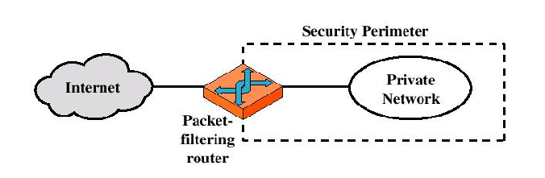
Types of Firewalls
Packet-filtering Router
Henric Johnson

Slide 11
Types of Firewalls
Packet-filtering Router
  Applies a set of rules to each incoming IP packet and then forwards or discards the packet.
  Filters packets going in both directions.
  The packet filter is typically set up as a list of rules based on matches to fields in the IP or TCP header.
  Two default policies (discard or forward).
Henric Johnson

Slide 12
Types of Firewalls
Advantages:
  Simplicity
  Transparency to users
  High speed
Disadvantages:
  Difficulty of setting up packet filter rules
  Lack of Authentication (IP spoofing attacks possible).
Henric Johnson

Slide 13
Types of Firewalls
Possible attacks and appropriate countermeasures
1. IP address spoofing
  //discard outside packets that contain an inside source address.//
  2. Source routing attacks
  >Source specifies a route that a packet should take.
  >May bypass security measures.
  >Discard all packets with this option.
Henric Johnson

Slide 14
Types of Firewalls
Possible attacks and appropriate countermeasures.
3. Tiny Fragment attacks:
  >Intruder uses IP fragmentation option to create extremely small fragments.
  >Forces TCP header information into a separate packet fragment.
  >Only the first fragment will be examined by the filtering router.
  >> Discard all such packets.
Henric Johnson

Slide 15
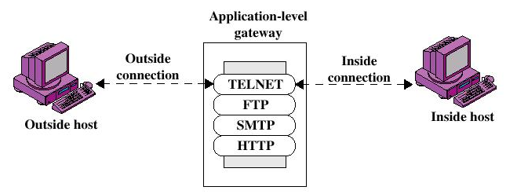
Types of Firewalls
Application-level Gateway
Henric Johnson

Slide 16
Types of Firewalls
Application-level Gateway
  Also called proxy server
  Acts as a relay of application-level traffic
Henric Johnson

Slide 17
Types of Firewalls
Advantages:
  Higher security than packet filters
  Only need to scrutinize a few allowable applications
  Easy to log and audit all incoming traffic
Disadvantages:
  Additional processing overhead on each connection (gateway as splice point)
Henric Johnson

Slide 18
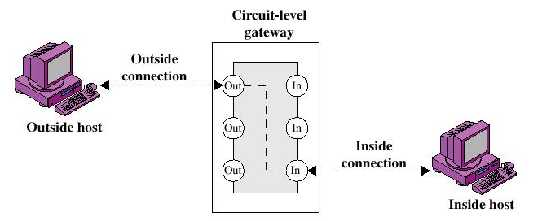
Types of Firewalls
Circuit-level Gateway
Henric Johnson

Slide 19
Types of Firewalls
Circuit-level Gateway
  Does not permit an end-to-end TCP connection.
  Sets up two TCP connections
  >One between itself and inner TCP user.
  >Second between itself and outside TCP host.
  The gateway typically relays TCP segments from one connection to the other without examining the contents
Henric Johnson

Slide 20
Types of Firewalls
Circuit-level Gateway
  The security function consists of determining which connections will be allowed
  Typically use is a situation in which the system administrator trusts the internal users.
  //low processing overheads.//
Henric Johnson

Slide 21
Types of Firewalls
Bastion Host
  A system identified by the firewall administrator as a critical strong point in the network´s security
  The bastion host serves as a platform for an application-level or circuit-level gateway
Henric Johnson

Slide 22
Firewall Configurations
In addition to the use of simple configuration of a single system (single packet filtering router or single gateway), more complex configurations are possible.
Three common configurations.
Henric Johnson

Slide 23
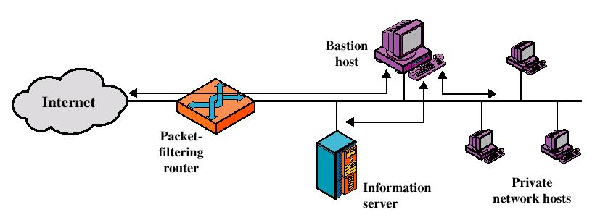
Firewall Configurations
Screened host firewall system (single-homed bastion host)
Henric Johnson

Slide 24
Firewall Configurations
Firewall consists of two systems:
  A packet-filtering router
  A bastion host
  >Only packets from and to the bastion host are allowed to pass through the router.
  -From Internet, only IP packets destined for the bastion host are allowed.
  -From internal network, only IP packets from bastion host are allowed out.
Henric Johnson

Slide 25
Firewall Configurations
Greater security than single configurations because of two reasons:
  This configuration implements both packet-level and application-level filtering (allowing for flexibility in defining security policy).
  An intruder must generally penetrate two separate systems.
Henric Johnson

Slide 26
Firewall Configurations
Provides flexibility in having direct access from Internet.
Internal network may include an information server for which tighter security is not required (like a Web server).
The router can allow direct traffic between the Internet and the information server.
Henric Johnson

Slide 27
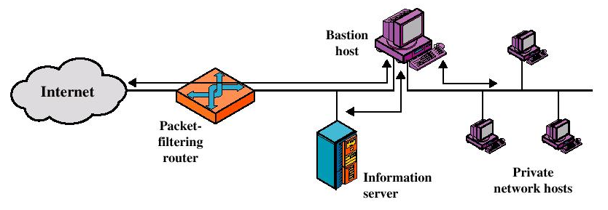
Firewall Configurations
Screened host firewall system
(dual-homed bastion host)
Henric Johnson

Slide 28
Firewall Configurations
  Traffic between the Internet and other hosts on the private network has to flow through the bastion host.
  If the packet-filtering router is completely compromised, traffic will not flow freely between Internet and protected network.
Henric Johnson

Slide 29
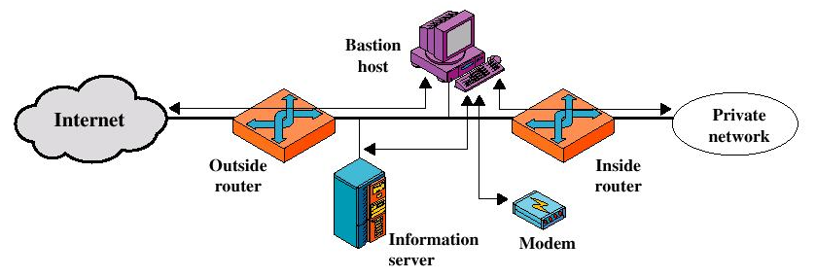
Firewall Configurations
Screened-subnet firewall system
Henric Johnson

Slide 30
Firewall Configurations
>Most secure configuration of the three.
>Two packet-filtering routers are used.
>Creation of an isolated sub-network.
Henric Johnson

Slide 31
Firewall Configurations
Advantages:
  Three levels of defense to thwart intruders.
  The outside router advertises only the existence of the screened subnet to the Internet (internal network is invisible to the Internet)
  Inside router advertises only the existence of the screened subnet to the internal network.
  (an inside host can not construct direct route to the Internet.)
Henric Johnson

Slide 32
Trusted Systems
One way to enhance the ability of a system to defend against intruders and malicious programs is to “implement trusted system technology”.
Henric Johnson

Slide 33
Data Access Control
Through the user access control procedure (log on), a user can be identified to the system.
Associated with each user, there can be a profile that specifies permissible operations and file accesses.
The operating system can enforce rules based on the user profile.
Henric Johnson

Slide 34
Data Access Control
General models of access control:
  Access matrix
  Access control list
  Capability list
Henric Johnson

Slide 35
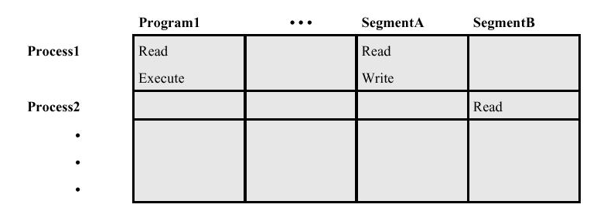
Data Access Control
Access Matrix
Henric Johnson

Slide 36
Data Access Control
Access Matrix: Basic elements of the model
  Subject: An entity capable of accessing objects. The concept of subject equates with that of process.
  Object: Anything to which access is controlled (e.g. files, programs).
  Access right: The way in which an object is accessed by a subject (e.g. read, write, execute).
Henric Johnson

Slide 37
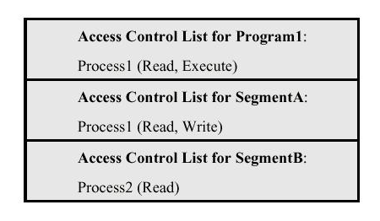
Data Access Control
Access Control List: Decomposition of the matrix by columns
Henric Johnson

Slide 38
Data Access Control
Access Control List
  An access control list lists users and their permitted access right.
  The list may contain a default or public entry.
Henric Johnson

